Slide 1


Vitis vinifera Metabolic Pathways: VitisCyc
Comparative and Omics Tools
Sushma Naithani, Ph.D.
Department of Botany & Plant Pathology

Slide 2
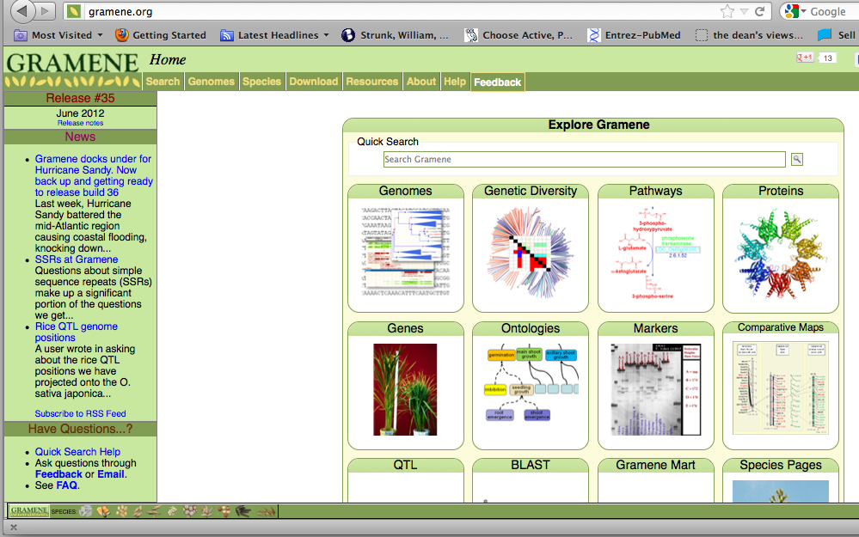
Gramene Homepage

Slide 3
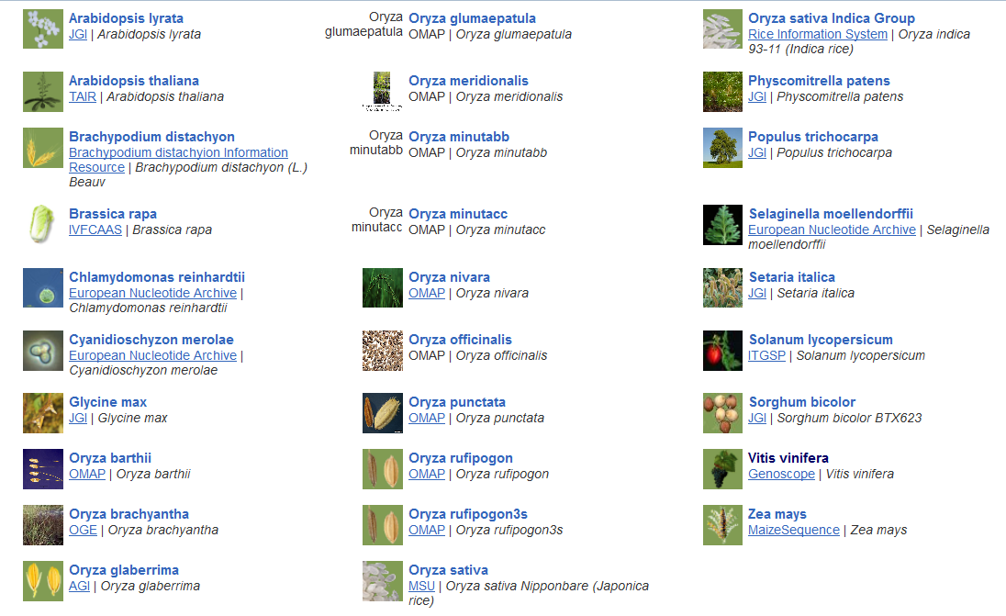
Gramene Database: Plant Genomes

Slide 5
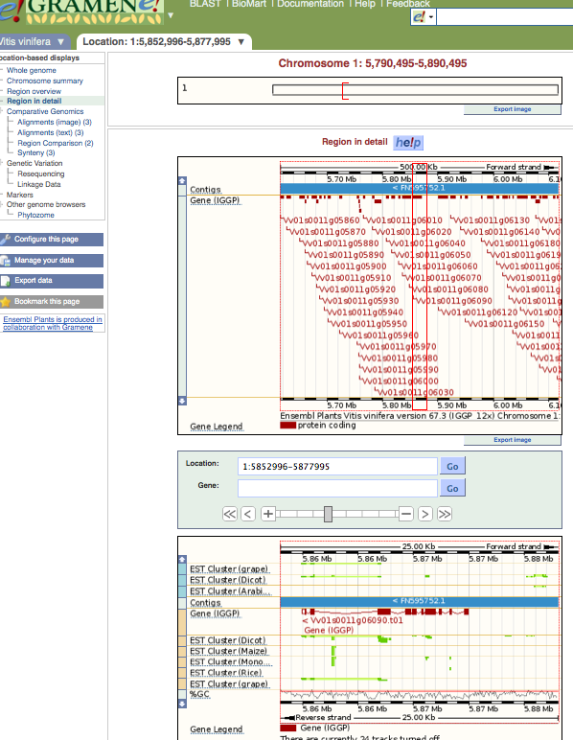
Upper Panel
Lower Panel

Slide 7
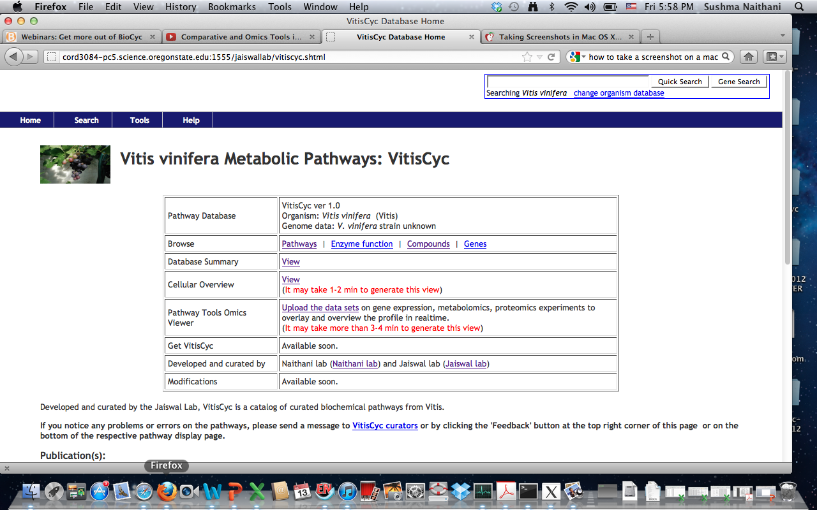
VitisCyc Web Interface
Notes:
Conceptually, VitisCyc is a representation of the interaction between metabolites as input and output molecules of i) a biochemical reactions where enzymes serve as catalyst.
or ii) a transport reactions where metabolites are transported from one compartment to another within the cell via transporter protein(s) or ion channels.

Slide 8
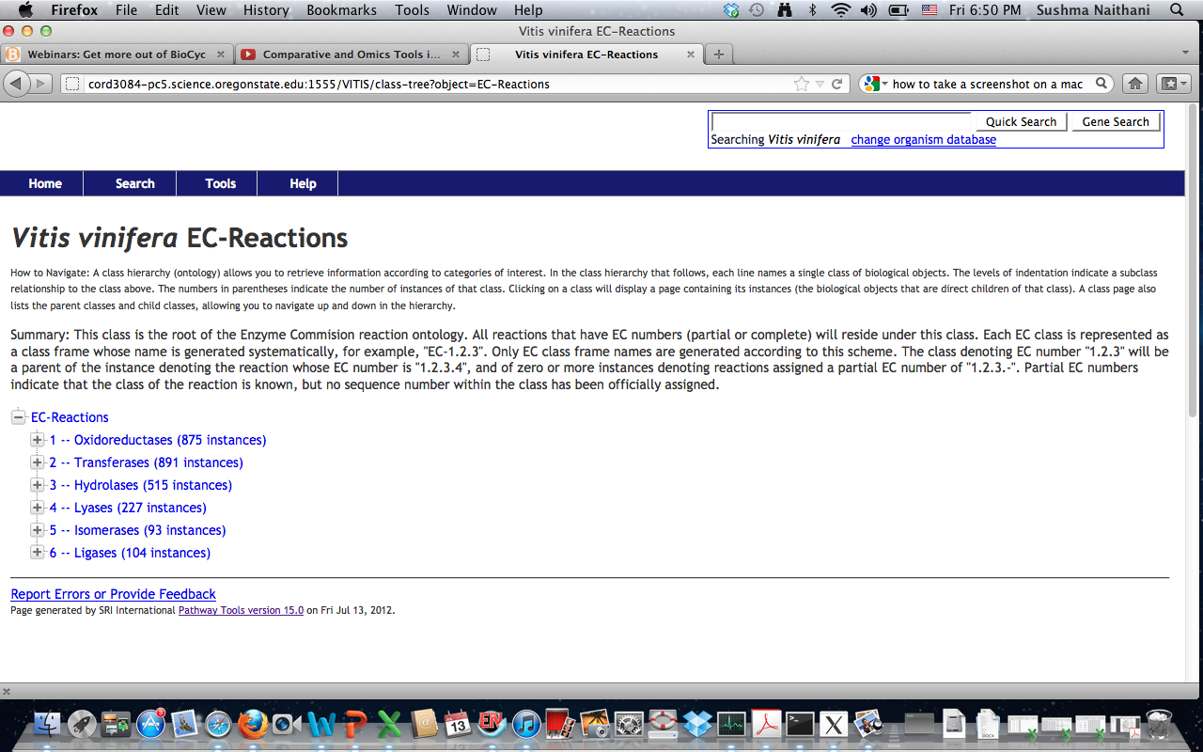
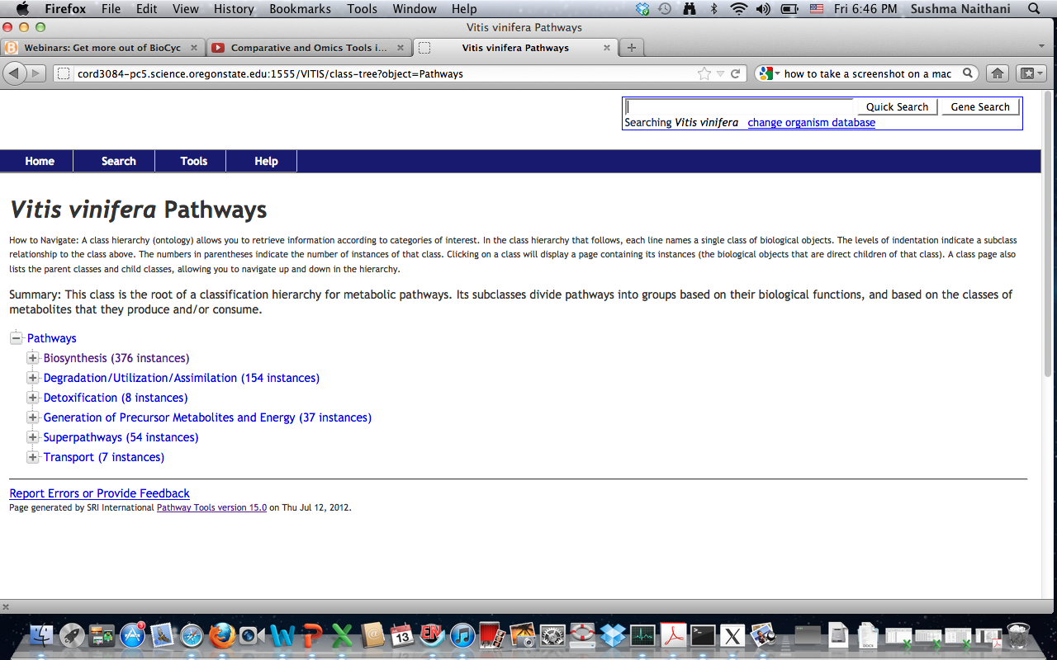
Pathway Browse Options
Notes:
one can simply browse pathways, or genes or enzymes in this database and can get information.

Slide 9
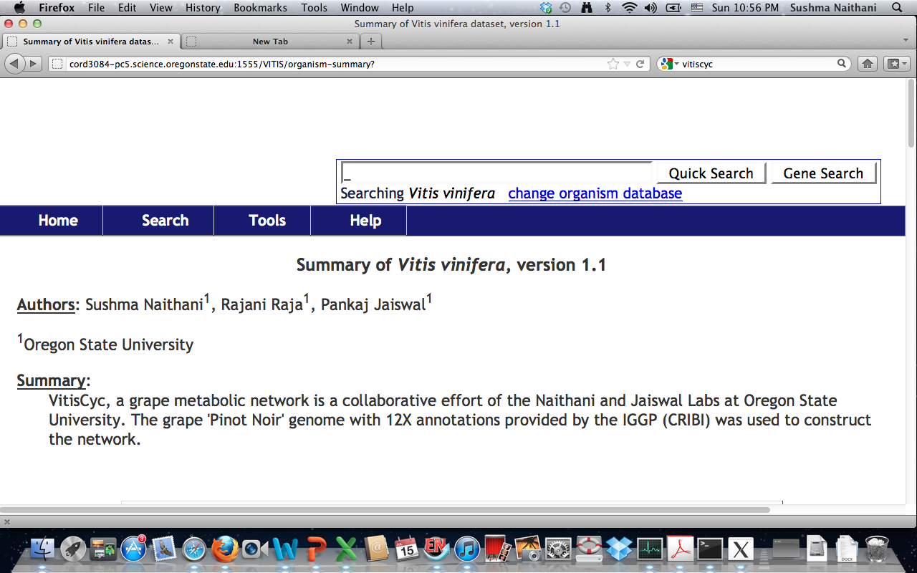
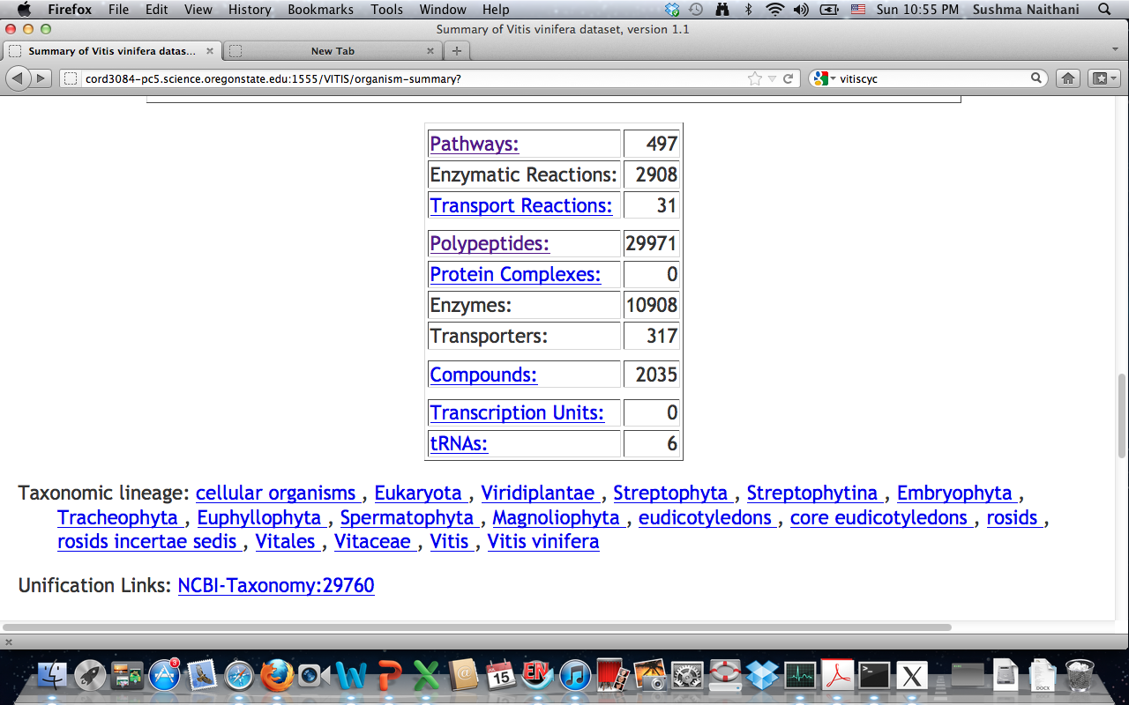

Slide 10
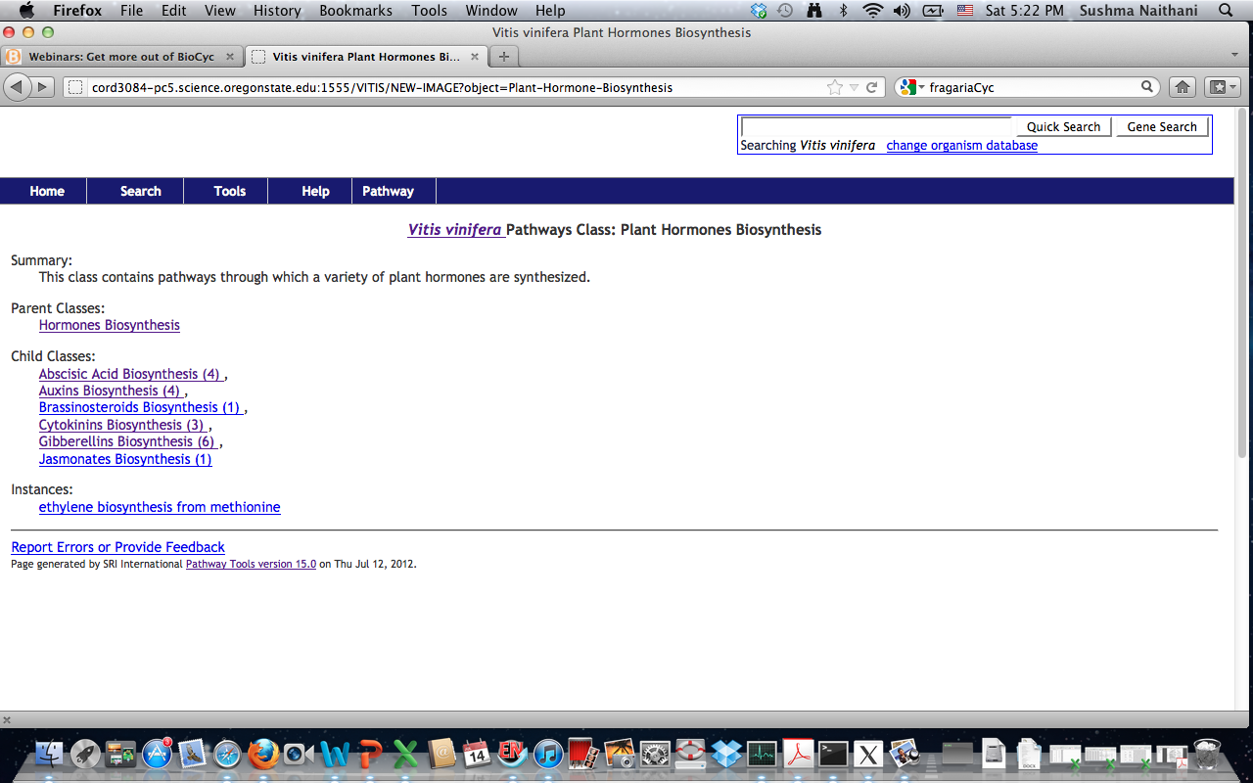
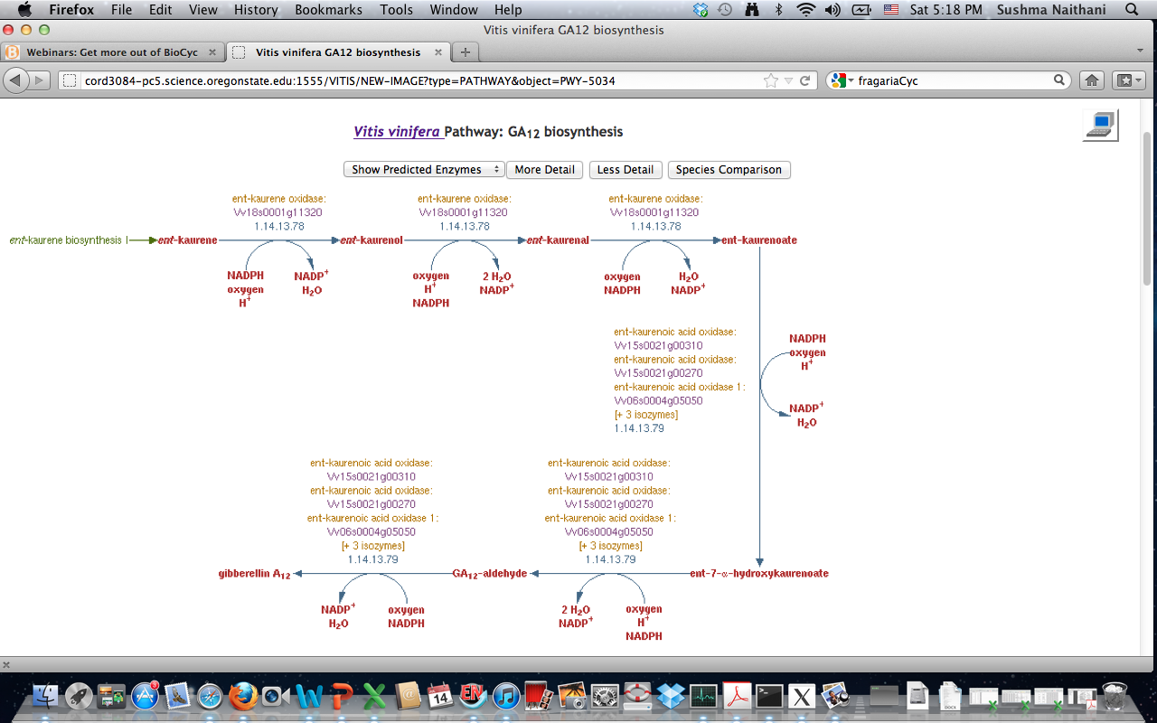
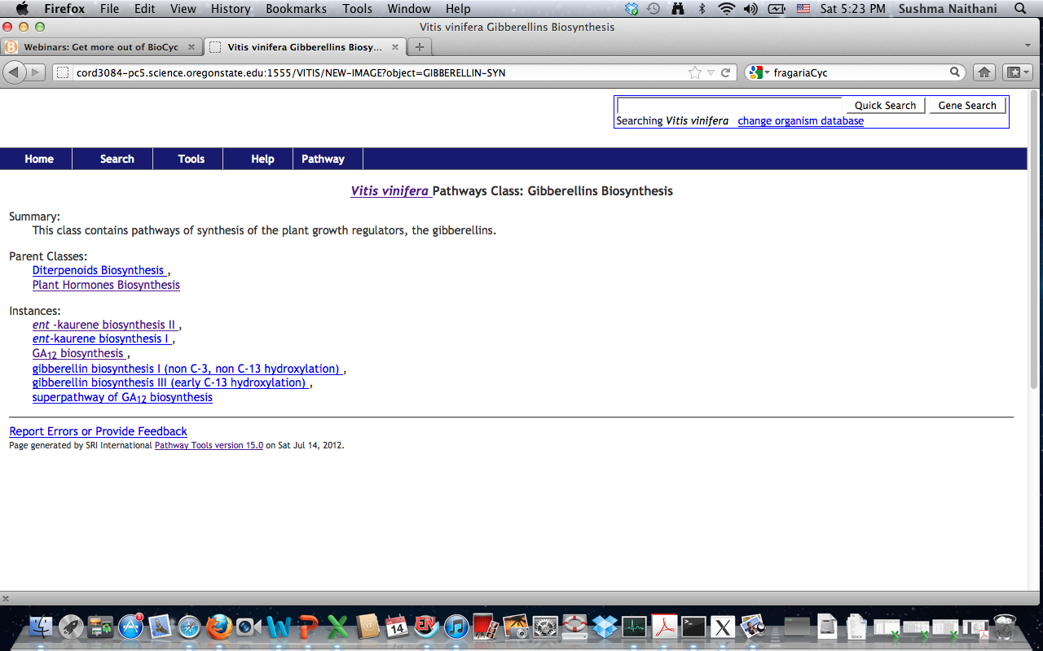
Search Example and Pathway Views
Zoom up to chemical structures
Enzyme
Metabolites and small molecules

Slide 11
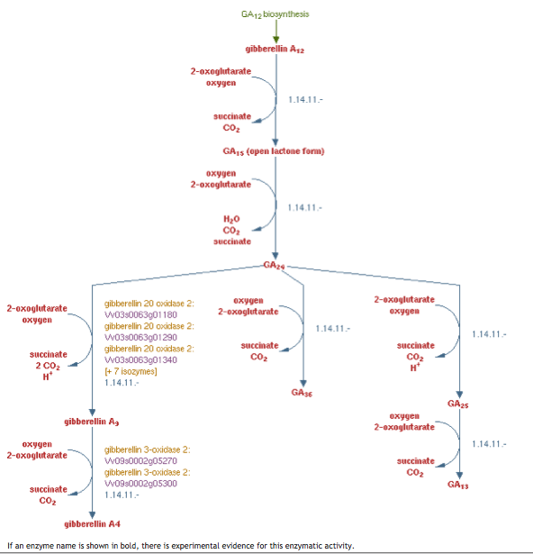
Vitis vinifera Pathway: Gibberellin Biosynthesis I (non C-3, non C-13 hydroxylation)
Manual curation
-identification of genes/ Evidence
Manual Curation
Evidence/support

Slide 12
PART 1. Cellular Overview
Pathway Tools Omics Viewer

Slide 13
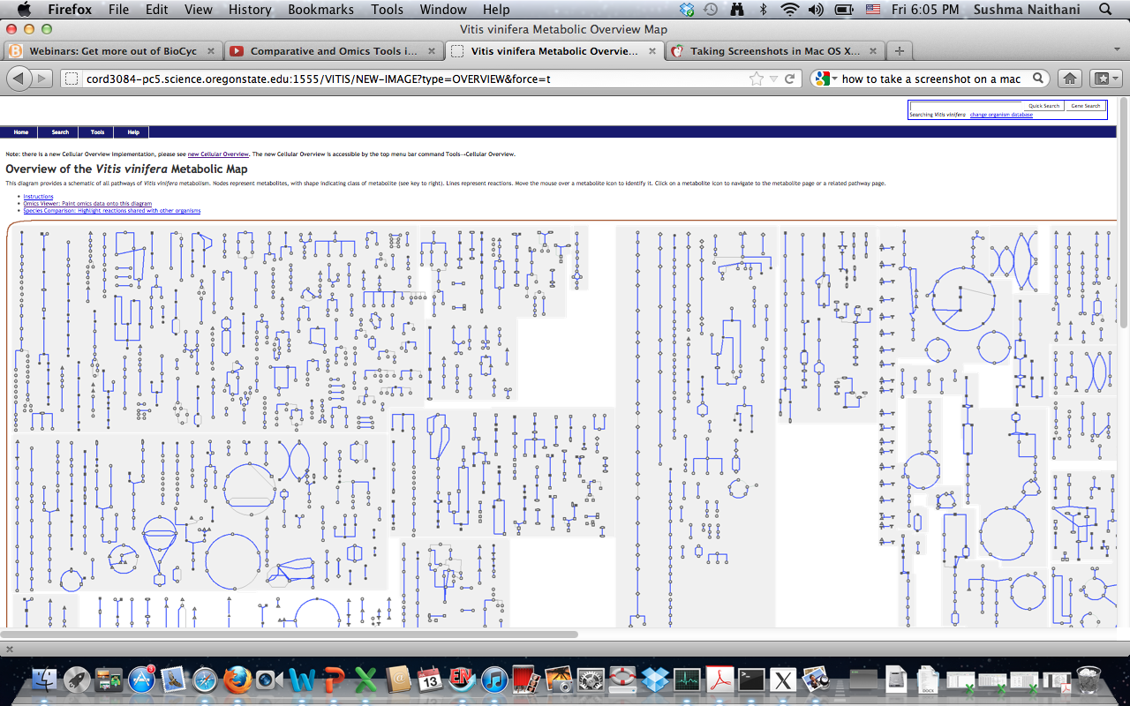
Overview of the Vitis vinifera Metabolic Map
Degradation
Generation of Precursor Metabolites and Energy
Biosynthesis

Slide 14
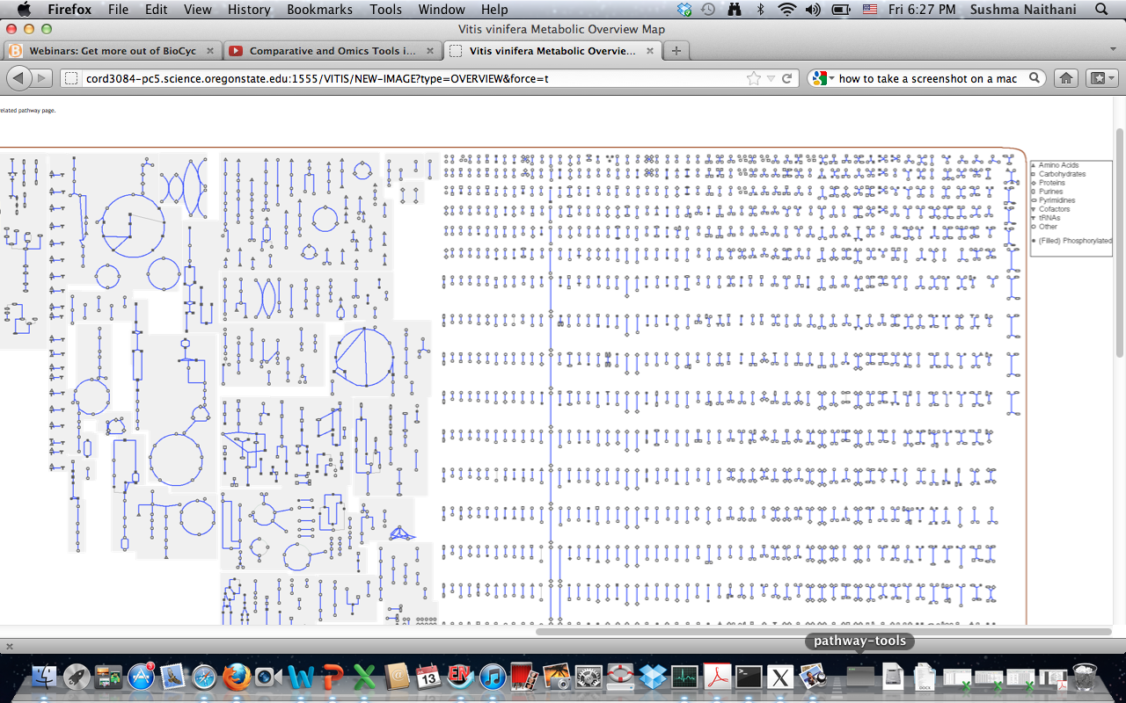
Super-pathways (54) : Biosynthesis (376),
Degradation/Utilization/Assimilation (154 ), Detoxification (8 ),
Energy related(37), Transport (7)
VitisCyc
KEYS
reactions and compounds not associated with pathways
Degradation
Notes:
The extreme right side contains reactions and compounds not associated with pathways, and a lot of manual input is needed to associate these reactions and components with pathways. the extreme rightside has keys and explain the meaning of different shapes. for example triangle represent amino acids, square carbohydrates and diamonds represent proteins. There are 54 super pathways in Vitis Cyc, which include 376 biosynthesis pathaway, 34 catbolic pathways, 8 detoxification, 37 energy related and 7 transport pathways.

Slide 15
Beyond Pathway Views and Comparison !
Can I analyze my data live using the Pathway views?

Slide 16
Examples

Slide 17
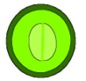
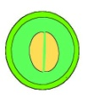
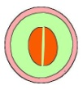

Grape berry Development & Ripening
Microarrays
PV
GSV
PSV
RSV
Berry Formation
Lag Phase
Véraison
Berry Ripening
Mid-véraison
Harvest
Current Model System
PV
Pre-véraison
GSV
Green Soft at véraison
PSV
Pink Soft at véraison
RSV
Red Soft at véraison
→
→
→

Slide 18
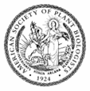
Plant Physiol, Volume 152(4):1787-1795, April 5, 2010
Characterization of Transcriptional Complexity during Berry Development in Vitis vinifera Using RNA-Seq
Sara Zenoni, Alberto Ferrarini, Enrico Giacomelli, Luciano Xumerle, Marianna Fasoli, Giovanni Malerba, Diana Bellin, Mario Pezzotti, and Massimo Delledonne
Table I.: Summary of read number
Post Fruit Set Véraison Ripening
No. of total reads 17,473,026 20,414,476 21,485,042
No. of mapped reads 14,221,092 16,747,270 17,974,725
Unique 10,875,728 13,949,356 14,713,154
Multi-match 3,345,364 2,797,914 3,261,571
No. of reads not mapped 3,249,965 3,526,757 3,423,777
©2010 by American Society of Plant Biologists

Slide 19
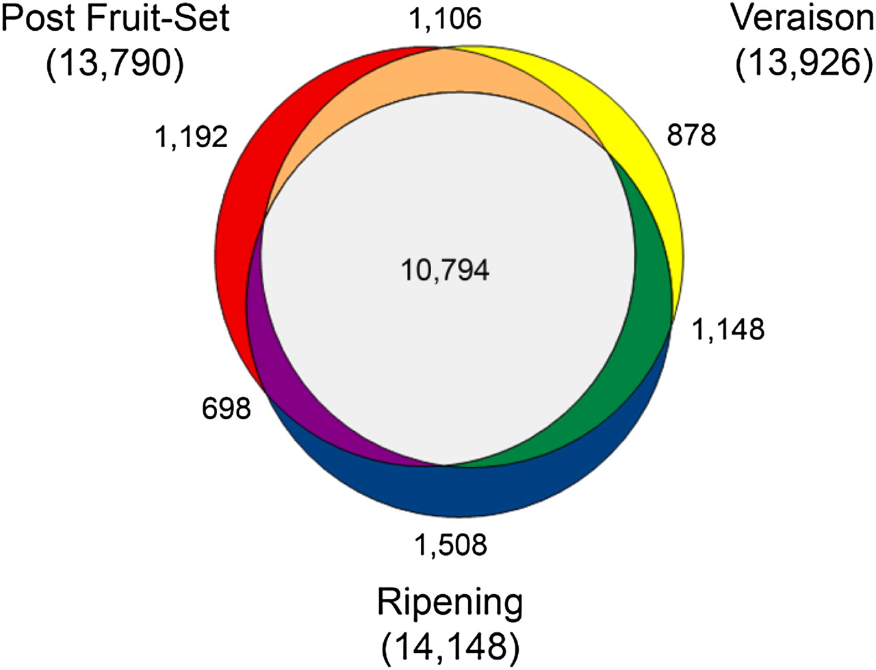
Venn diagram showing the genes expressed in each of the three stages of berry development.
©2010 by American Society of Plant Biologists
Zenoni S et al. Plantphysiol 2010;152:1787-1795
Notes:
Venn diagram showing the genes expressed in each of the three stages of berry development.

Slide 20
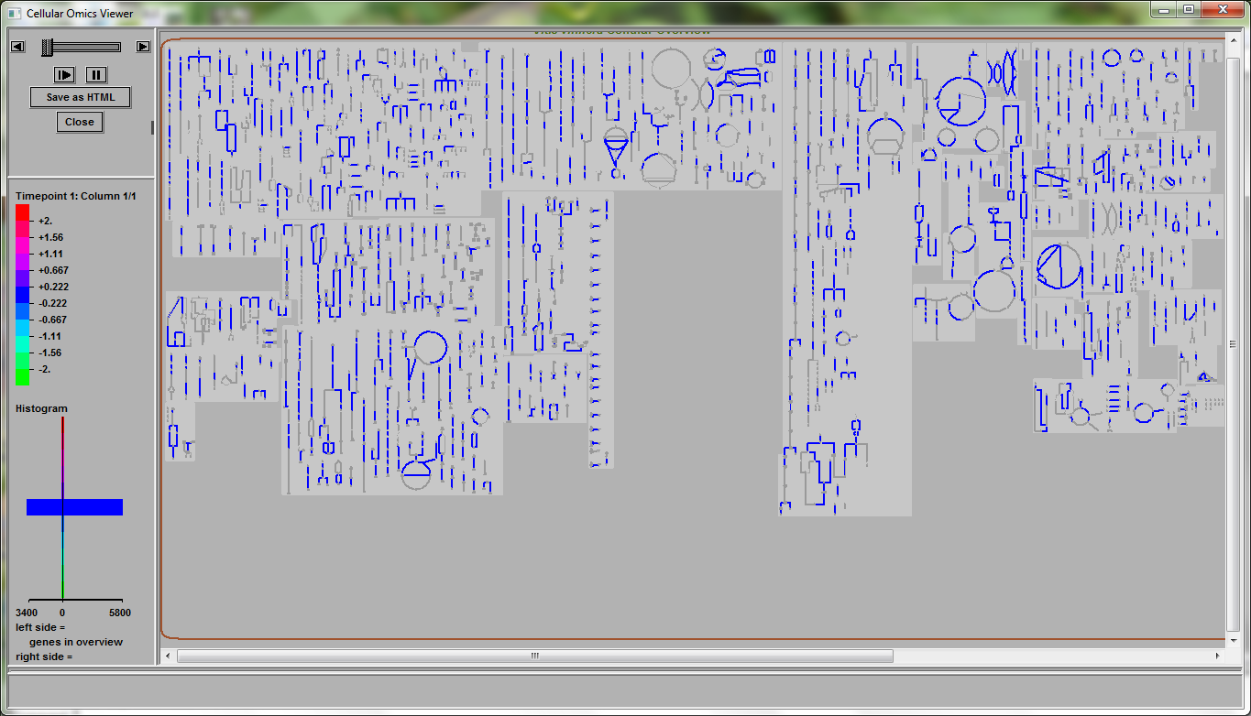
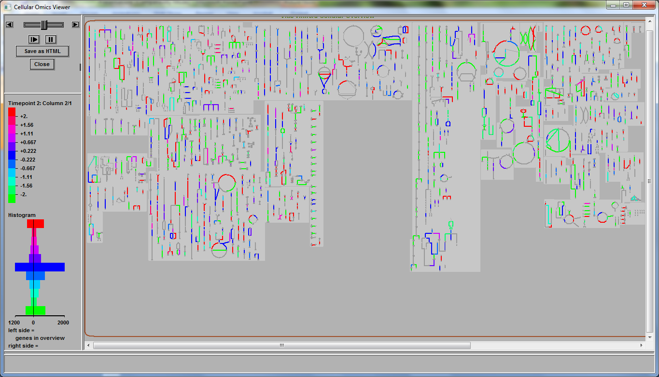
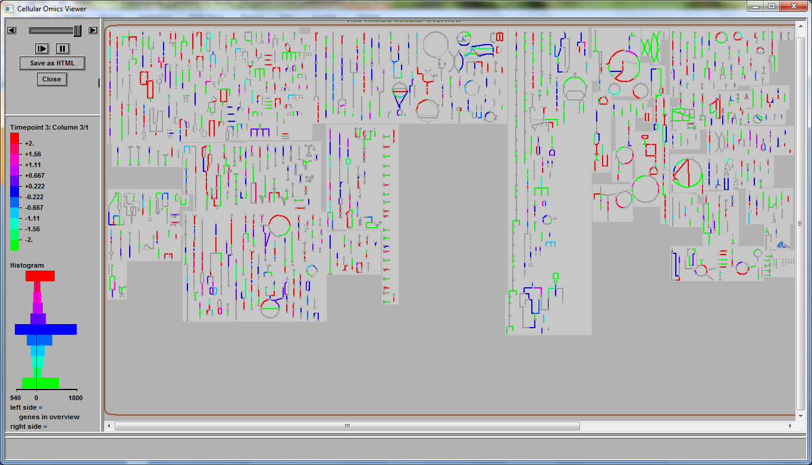
Zenoni et al RNA-seq expression data. RPKM values analyzed by looking for genes preferentially expressed in 10 and 15 weeks compared to the 5 week sample. Maximum cutoff used = 2
Lignin biosynthesis
About 9,000 genes are differentially expressed. Of these ~3400 in 5-week sample, ~1200 in 10-week and ~900 in 15-week sample mapped to the VitisCyc metabolic network.
5-week Fruit set stage
10-week Veraison stage
15-week Ripening stage

Slide 21
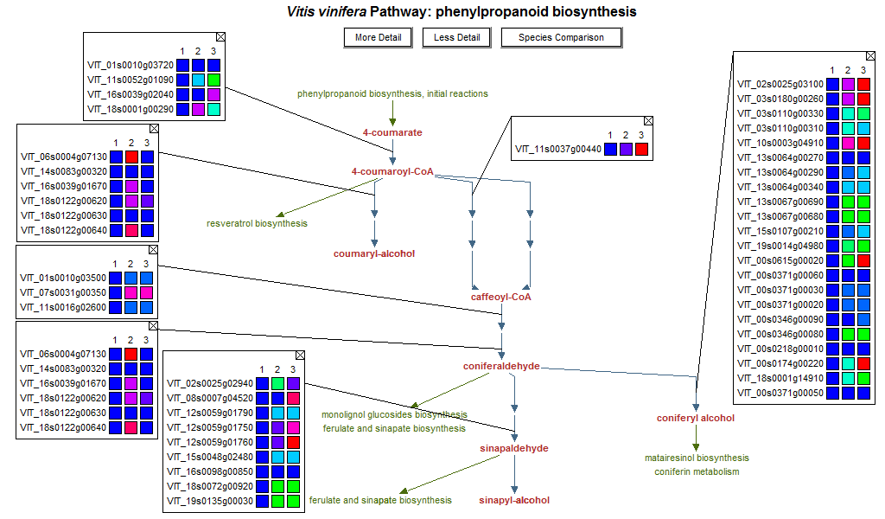
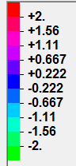
Lignin Biosynthesis
Fs V R
Fs V R
Fs V R
Fs V R

Slide 22
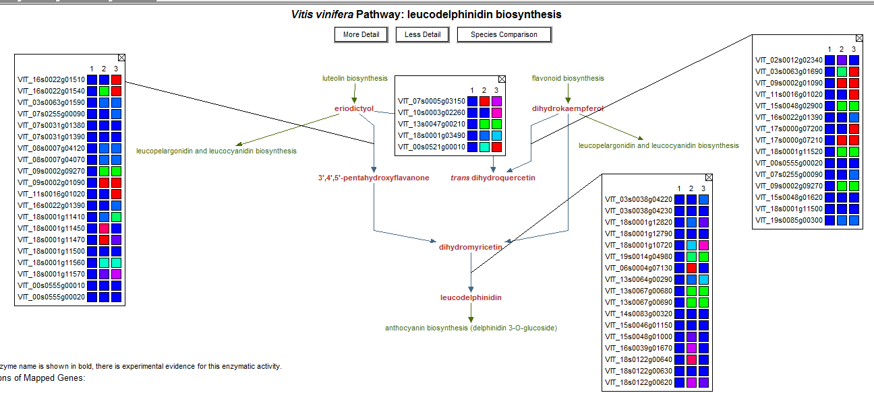
Leucodelphinidin Flavonoid Biosynthesis
Fs V R
Fs V R
Fs V R
Fs V R

Slide 23
Funding National Science Foundation Oregon State University USDA-ARS Collaborators Cold Spring Harbor Laboratory Oregon State University European Bioinformatics Institute Ontario Institute for Cancer Research American Society for Plant Biologists Cornell University All of you !
Acknowledgements
Palitha Dharmawardhana
Vindhya Amarasinghe
Samuel Fox
Sushma Naithani
Mamatha Hanumappa
Justin Preece
Abigail Sage
Dylan Beorchia
Kendra
Ken Clark
Sharon Wei
Doreen Ware
Jim Thomason
Paul Kersey
Helen Parkinson
Lincoln Stein
McCouch Lab
Buckler Lab

Slide 24
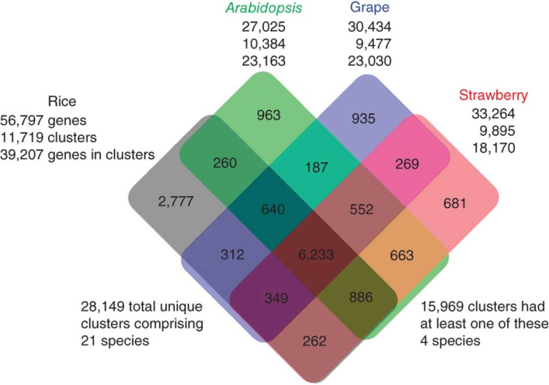
Genome Annotation and Curation of Metabolic Pathways
Shulaev et. al 2011. Nat Genet., 43:109-116. .

Slide 25
Gramene’s Key Strengths
Comparative genomics
Complete reference genomes for 19 plant species including several Oryza species
Whole genome alignments
Phylogenetic gene trees
Gene annotations
Extensive variation data sets for rice, maize, Arabidopsis and others.
Integration with Pathways databases
Comparison to genetic maps, markers, genes, and QTLs
Ability to upload, analyze and share data
Data mining using Gramene Mart your genomics shopping cart

Slide 26
Search Example and Pathway Views

Slide 27
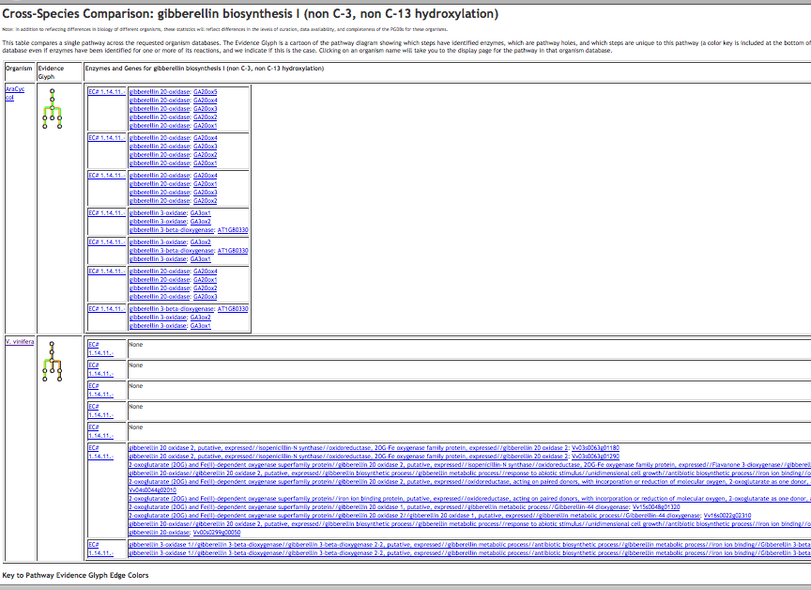
Cross-Species Comparison: gibberellin biosynthesis I (non C-3, non C-13 hydroxylation)
Click to visit the reaction
Click to visit pathway
Click to visit the Gene/ gene product

Slide 28
The Pathway Tools Omics Viewer
A. Microarray Expression Data and/or RNA-Seq data:
Allows interpretation of results in a pathway context and allows comparisons among various samples.
Reaction lines (and protein icons) are color-coded according to the relative or absolute expression level of the gene that codes for the enzyme that catalyzes that reaction step.
B. Proteomics Data: Reaction lines (and protein icons) are color-coded according to the concentration of the enzyme that catalyzes that reaction step.
C. Metabolomics Data: Compound icons are color-coded according to the concentration of the compound.
D. Reaction Flux Data: Reaction lines are color-coded according to reaction flux values.

Slide 29
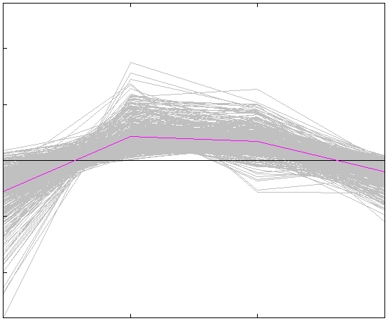
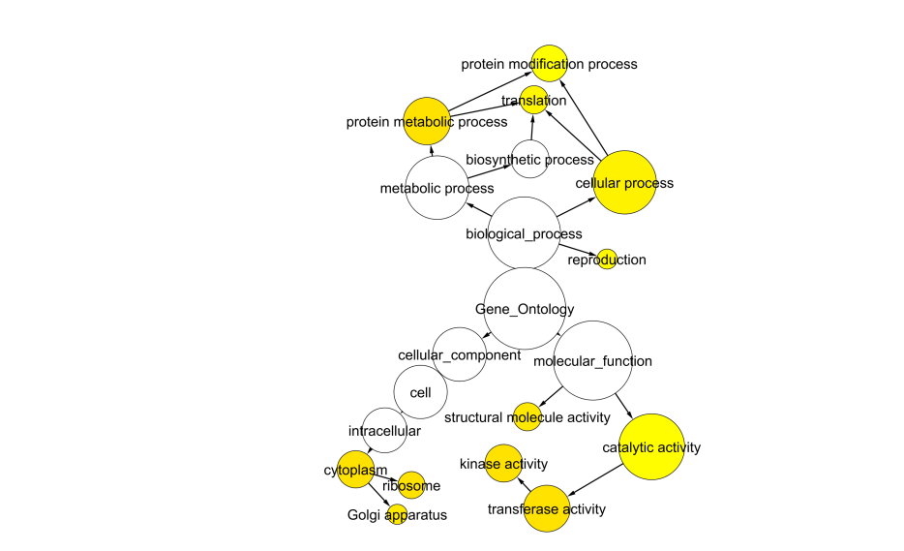
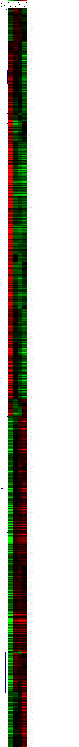
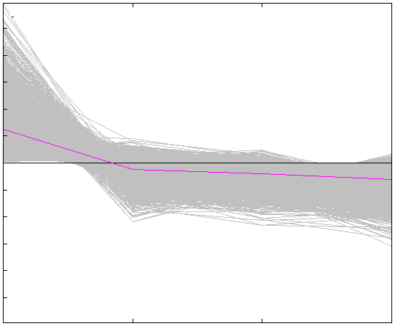
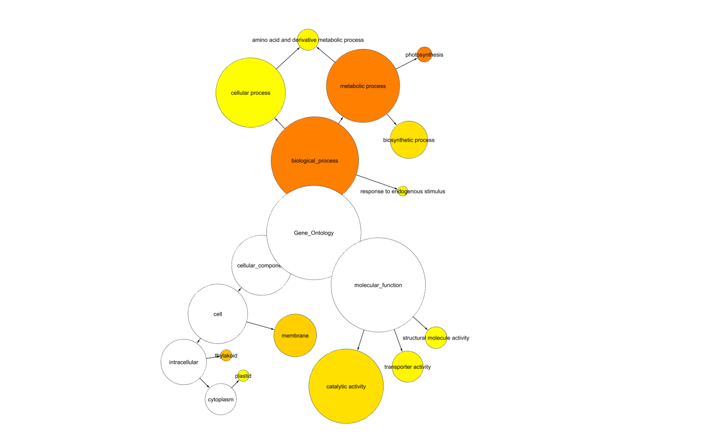
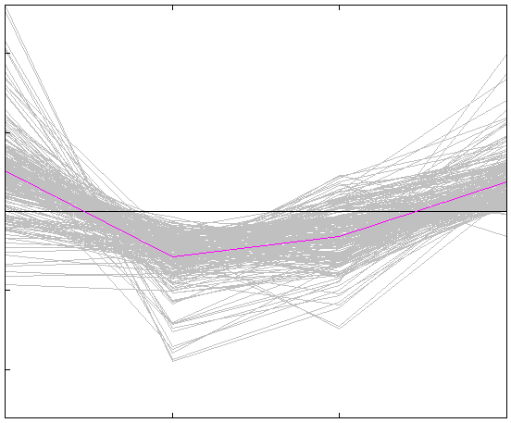
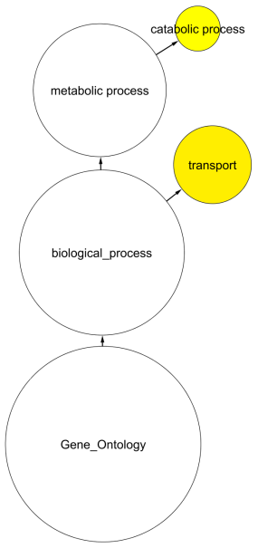
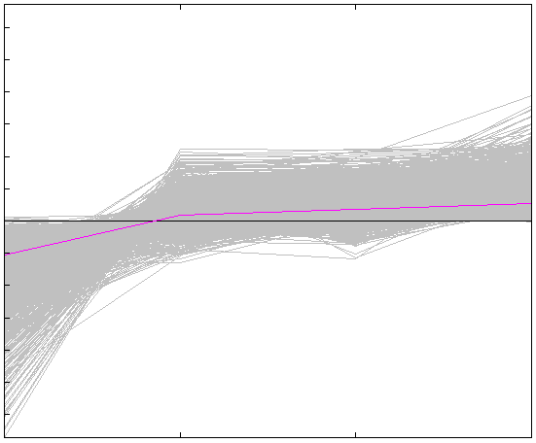
Microarray data from Pulp
GH GS PS RS

Slide 30
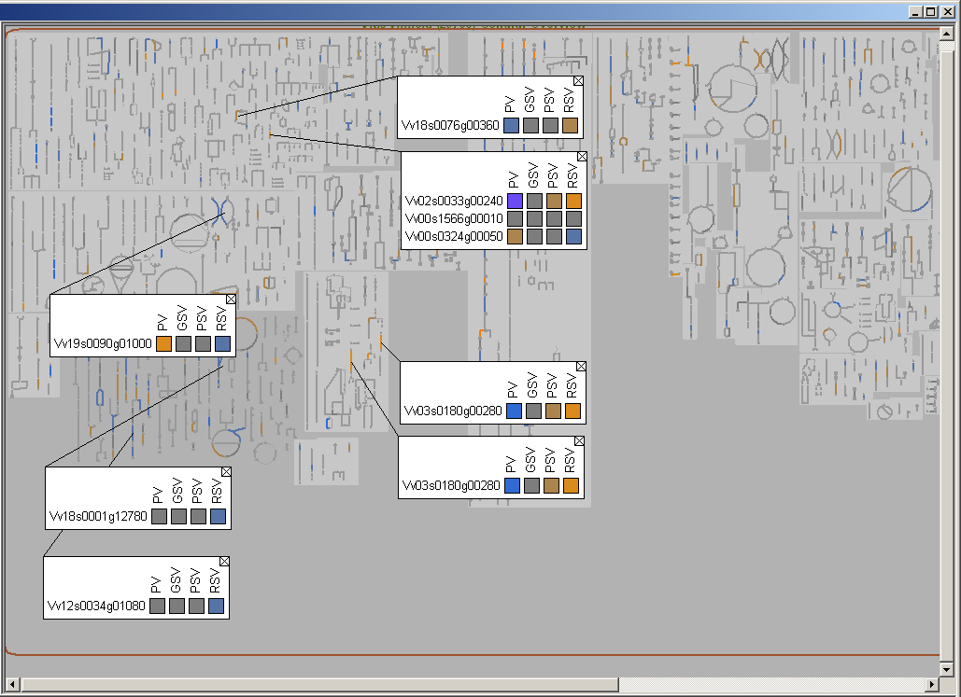
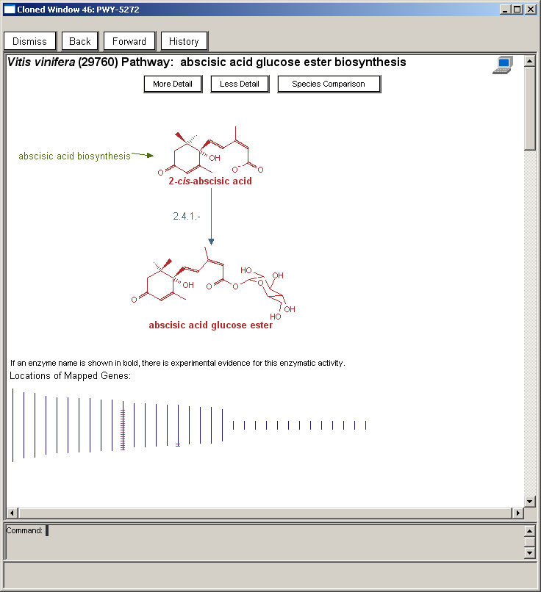
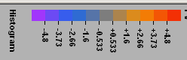
VitisCyc: Metabolic Overview of Grape Berries
Phenylethanol Biosynthesis
Anthocyanin Biosynthesis
Ascorbic acid Biosynthesis
Abscisic acid Biosynthesis
IAA conjugate Biosynthesis I
Arginine
Biosynthesis
Leucine Biosynthesis

Slide 31
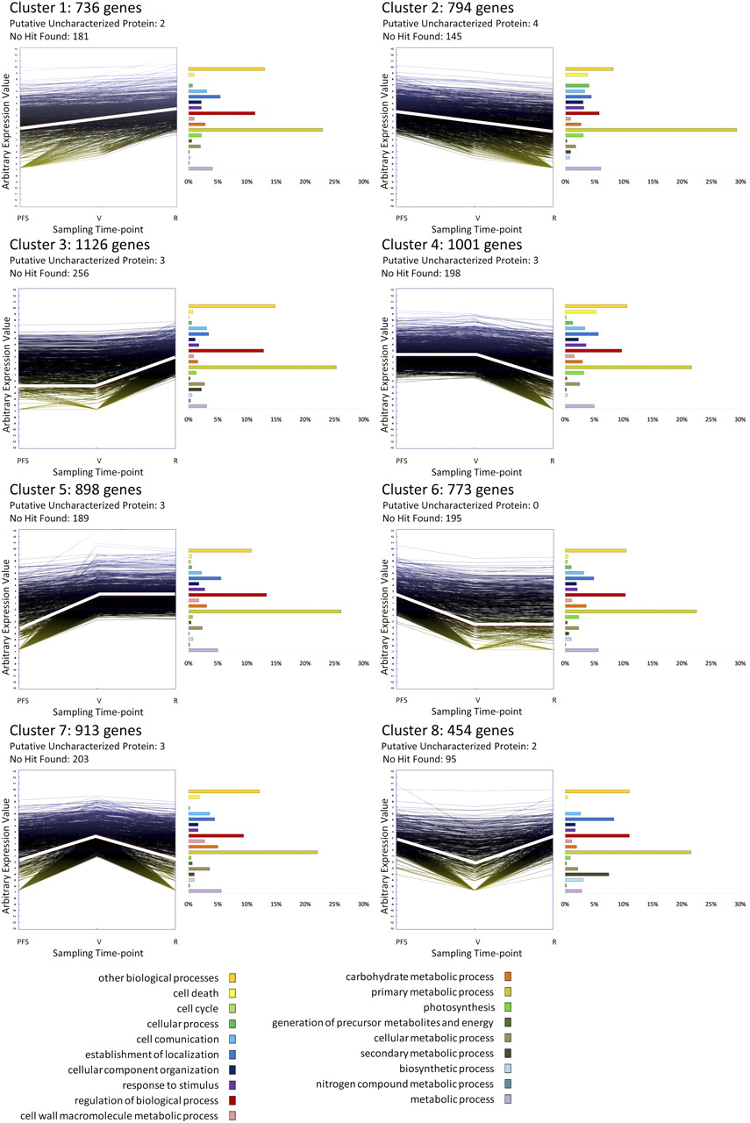
Categories distribution in the eight expression clusters.
Total # of expressed genes= 17,324
Genes expressed in stage-specific manner= 6,695
# of up-regulated genes during Veraison or ripening= 4320
# of up-regulated genes mapped to metabolic pathways =1613
Zenoni S et al. Plantphysiol 2010;152:1787-1795
©2010 by American Society of Plant Biologists
Notes:
Categories distribution in the eight expression clusters. Clusters were obtained by the k-means method on the gene expression profiles of the 6,695 modulated genes. Histogram representation of the functional categories distribution is expressed as percentage of the amount of genes belonging to the cluster. Gene coding for unknown products were not considered in the analysis. PFS, Post fruit set; R, ripening; V, véraison.
#1 & 2 cluster=+ively or –ively regulated whole time
#3&4 clusters= only during preveraison intervals
5&6 cluster= gene modulated after veraison
cluster 7=late stage
cluster 8=veraison

